Slide 1
DECIDING WITH CONFIDENCE

Slide 2
Only D&B has the five essential elements that transform information into quality insight
Global Data Collection
Entity Matching
D-U-N-S® Number
Corporate Linkage
Predictive Indicators
DUNSRight®
2

Slide 3
What does that mean to you?
For you, that translates into greater coverage, more accuracy, and better insight into the companies and people you do business with.
D&B’s Global Data Strategy is designed to give you better, more relevant insight, so you can make all your business decisions consistently, efficiently, and with confidence:
Deeper insight: Know more about the companies you do business with—and where they’re headed.
Expanded small-business insight: Know how to grow your business in the small-business market.
Broader insight: Know more about your risks and opportunities when doing business globally
Access to rest-of-world insight:
Supplement what you can learn from D&B with relevant data from outside sources.

Slide 4
Element 1: Global Data Collection
D&B’s Global Data Collection:
Collects, integrates, and updates data from thousands of sources
Constantly increasing coverage
Automating and refining data collection
Your competitive advantage:
Global reach
Access to critical information
Notes:
We support you with: GLOBAL DATA COLLECTION
D&B’s Global Data Collection continually collects, integrates, and updates business data from thousands of sources worldwide. We watch how the world is changing and how businesses are defined.
We increase our coverage in a way that ensures we evolve with the world, managing the pace of change by automating and refining our means of collecting data.
Competitive advantage: None of D&B’s competitors have the global reach that D&B has. The D&B name and brand provides us access to information that would be difficult for others to get. Global Data Collection is our business. As a D&B customer, you have access to the most complete information available.

Slide 5
Element 1: Global Data Collection
The result:
You get a world of information, all in one place
So, without having to search, you get the critical information you need to know about virtually any business, anywhere
So you can spend more time focusing on what’s important to your business
Notes:
The result: Without having to search, you get the critical information you need to know about virtually any business, anywhere. And since you spend less time searching for the information you need, you can spend more time focusing on what’s important to your business.

Slide 6
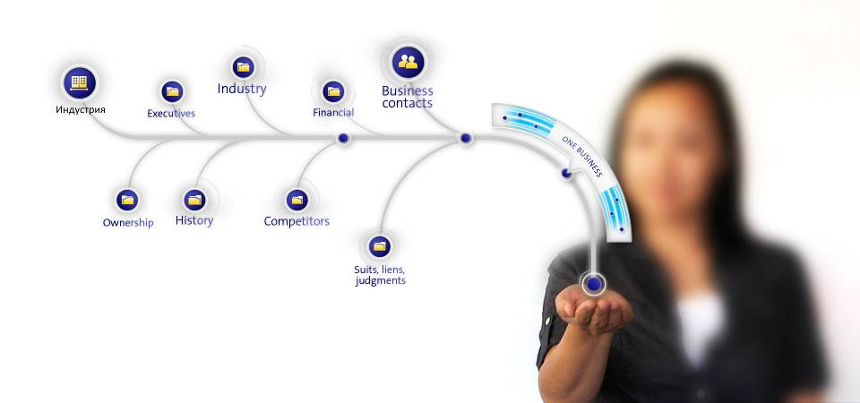
Element 2: Entity Matching
Notes:
We support you with: ENTITY MATCHING
D&B Entity Matching brings together disparate pieces of data, finds what’s related, and makes the connections for you—combining all that data it into a single business, for a complete picture of your customers and prospects.
Competitive advantage: None of D&B’s competitors have our patented matching technology—and none of them can apply matching technology to the amount—and quality—of data we can Because of that, we bring you a more comprehensive, more accurate picture of any business And we can do this: Across multiple languages With your own data
So, as a D&B customer, you’re able to: Better understand your risk exposure or opportunities with any business Find prospects that look like your best customers See the true size of any business you are working with to uncover hidden up-sell and cross-sell opportunities—and hidden risks

Slide 7
Element 2: Entity Matching
D&B’s Entity Matching:
Brings together disparate pieces of data
Finds what’s related—what matches—and pulls it together
Makes connections for you
Combines all that data into a single view of any business
Your competitive advantage:
Unique matching technology
Applied to more, better data—the D&B Global Database
Works across multiple languages
Works with your internal data
Notes:
We support you with: ENTITY MATCHING
D&B Entity Matching brings together disparate pieces of data, finds what’s related, and makes the connections for you—combining all that data it into a single business, for a complete picture of your customers and prospects.
Competitive advantage: None of D&B’s competitors have our patented matching technology—and none of them can apply matching technology to the amount—and quality—of data we can Because of that, we bring you a more comprehensive, more accurate picture of any business And we can do this: Across multiple languages With your own data
So, as a D&B customer, you’re able to: Better understand your risk exposure or opportunities with any business Find prospects that look like your best customers See the true size of any business you are working with to uncover hidden up-sell and cross-sell opportunities—and hidden risks

Slide 8
Element 2: Entity Matching
A.B.C.
123 Elm St.
Bethlehem, PA 18025
(SIC) 5411-02
Chuck Smith, President
D&B D-U-N-S Number: 12-345-6780
ABC, Inc
+ Alpha Plastics
P.O. Box 111
Bethlehem, PA 18055
123 Elm St.
Bethlehem, PA 18025
(SICs) 5411 0202, 5541 9901
Charles Smith, President
Mary Worth, VP Marketing
Chris White, Controller
610 882-7600
Alpha Plastics
P.O. Box 111
Bethlehem, PA 18055
(SIC) 5411-02
Chuck Smith, President
610 882-7600
Charles Smith
123 Elm St.
Bethlehem, PA 18025
(SIC) 5541-99
215 882-7600
Multiple unmatched records
Single view of your customer

Slide 9
Element 2: Entity Matching
The result:
You learn everything you need to know about any aspect of virtually any business
So you can manage risk effectively and find more new business
You can match D&B information with your internal data
So you can better understand your best customers—and find more like them
Notes:
The result: When you look up a company, you learn everything you need to know about any aspect of that business. With that insight, you can manage risk more effectively and find more new business.
And to make things even more relevant, you can match D&B information with your internal data—combining the best of our data with the best of your data to show you everything you need to know about a business, giving you a more comprehensive, more practical view of any business upon which to base critical business decisions. When you understand the characteristics of your best customers, it makes it easier to find more like them

Slide 10
Element 3: D-U-N-S Number
D&B’s proprietary D-U-N-S Number:
Track a business, and its activities, anywhere in the world, for as long as it exists—and even after it closes, if you need to
Your competitive advantage:
See and track any business in a way that nobody else can without access to the capabilities that the D-U-N-S Number enables
Notes:
We support you with:: THE D-U-N-S® NUMBER The engine behind DUNSRight is D&B’s proprietary D-U-N-S Number. It allows us to track a business, and its activities, anywhere in the world, for as long as it exists—and even after it closes, if you need to.
Competitive advantage: None of D&B’s competitors have the D-U-N-S Number. It’s the key to all our capabilities, and to all our products and services. Nobody else can replicate it—and business worldwide depends on it.

Slide 11
Element 3: D-U-N-S Number
The result:
As soon as D&B knows about a change to a business, so do you
You don’t lose track of a customer, prospect, or supplier
If a company is truly new, you know
You can also track your own data using the D-U-N-S Number
Notes:
We support you with: THE D-U-N-S® NUMBER The result: You never lose track of a customer, prospect, or supplier, no matter how they change. And if a company is truly new, you know that, too. The D-U-N-S Number can also be used to tag and track your data, so you can see how changes outside your company affect what’s going on inside.

Slide 12
Element 4: Corporate Linkage
Notes:
We support you with: CORPORATE LINKAGE D&B’s Corporate Linkage recognizes related businesses and maps their relationships for you.
Competitive advantage: D&B can show you relationships nobody else can Corporate linkage works for all sizes and types of businesses It covers both the private and public sectors It works internationally It offers more coverage than anyone else—our coverage of commercial relationships alone is larger than our competitors’ full files And it’s constantly growing—we track new and emerging relationships that are created overnight as mergers or acquisitions occur, branches close, or other shifts happen

Slide 13
Element 4: Corporate Linkage
D&B’s Corporate Linkage:
Recognizes related businesses and maps their relationships for you
D&B captures Majority & Minority Linkage
Your competitive advantage:
See relationships you can’t see anywhere else
Works for all sizes and types of businesses
Covers private and public sectors
Works internationally
Greater coverage than anyone else—and it’s constantly growing
Notes:
We support you with: CORPORATE LINKAGE D&B’s Corporate Linkage recognizes related businesses and maps their relationships for you.
Competitive advantage: D&B can show you relationships nobody else can Corporate linkage works for all sizes and types of businesses It covers both the private and public sectors It works internationally It offers more coverage than anyone else—our coverage of commercial relationships alone is larger than our competitors’ full files And it’s constantly growing—we track new and emerging relationships that are created overnight as mergers or acquisitions occur, branches close, or other shifts happen

Slide 14
Element 4: Corporate Linkage
The result:
You know who owns what
You can see hidden up-sell and cross-sell opportunities—both inside and outside your portfolio
You know when and where to consolidate spending
Notes:
The result: You know who owns what, across every branch of the corporate family tree. You can see hidden up-sell and cross-sell opportunities—both inside and outside of your portfolio. And you know when and where it makes sense to consolidate spending.

Slide 15
Element 5: Predictive Indicators
Notes:
We support you with: PREDICTIVE INDICATORS D&B’s Predictive Indicators are derived by our statistical experts, who analyze data to build complex models. These models, combined with D&B’s unparalleled depth and breadth of data, show where a business is headed.
Competitive advantage: D&B brings you insight derived using a database and capabilities that no one else has D&B delivers predictive insight based on data we get from proprietary relationships, that help us capture valuable, predictive information including: Payment experiences Financial statements

Slide 16
Element 5: Predictive Indicators
D&B’s Predictive Indicators:
Show you where a business is headed
Your competitive advantage:
Gain insight—and foresight—you can’t get anywhere else
Based on D&B’s:
Unique capabilities
Global Database
Proprietary relationships that capture exclusive information
Notes:
We support you with: PREDICTIVE INDICATORS D&B’s Predictive Indicators are derived by our statistical experts, who analyze data to build complex models. These models, combined with D&B’s unparalleled depth and breadth of data, show where a business is headed.
Competitive advantage: D&B brings you insight derived using a database and capabilities that no one else has D&B delivers predictive insight based on data we get from proprietary relationships, that help us capture valuable, predictive information including: Payment experiences Financial statements

Slide 17
Element 5: Predictive Indicators
The result:
You know not only how a business behaves today, but also how it may behave tomorrow—and you can convert that knowledge into opportunity
Notes:
We support you with: PREDICTIVE INDICATORS The result: You know not only how a business behaves today, but also how it may behave tomorrow—and you can convert that knowledge into opportunity. So you can make critical business decisions with confidence.

Slide 18
D&B Database at a Glance (Jan 2013)
Всего |  |  | Активные |  |  | Полные данные |  |  | Связанные |  |  | Неявные связи
 | Всего |  | Всего | Процент |  | Всего | Процент |  | Всего | Процент |  | Всего | Процент
 | Компаний |  | активных | От |  | Компаний | От |  | Связанных | от |  | неявных | от
Регион | в D&B |  | компаний | Общего числа |  | С полными данными | Общего числа |  | компаний | Активных компаний |  | связей | Всех компаний
Африка | 2,473,815 |  | 1,232,897 | 49.21% |  | 617,897 | 24.97% |  | 39,660 | 3.08% |  | 2,940 | 0.12%
Азия и Тихий Океан | 37,448,453 |  | 30,064,581 | 80.28% |  | 10,205,393 | 29.77% |  | 3,411,943 | 12.06% |  | 106,531 | 0.30%
Европа | 91,908,705 |  | 55,640,917 | 60.53% |  | 42,018,592 | 48.71% |  | 8,602,243 | 14.70% |  | 2,060,112 | 2.35%
Ближний Восток | 1,152,406 |  | 1,056,029 | 92.75% |  | 232,358 | 27.30% |  | 23,768 | 2.32% |  | 1,697 | 0.16%
Латинская Америка | 19,106,040 |  | 16,334,068 | 88.37% |  | 11,151,395 | 47.06% |  | 1,494,211 | 8.73% |  | 13,185 | 0.10%
Северная Америка | 71,027,632 |  | 31,323,773 | 46.12% |  | 22,124,360 | 32.24% |  | 3,102,023 | 9.47% |  | 932,540 | 1.35%
Всего | 223,117,051 |  | 135,652,265 | 60.79% |  | 86,349,932 | 38.70% |  | 16,673,858 | 12.29% |  | 3,117,005 | 1.49%

